Slide 1
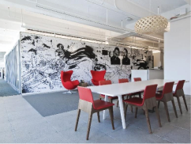


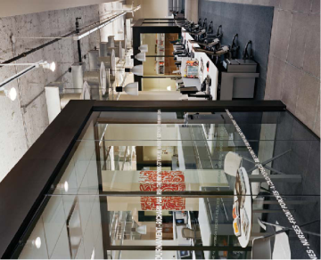


C team
- Jim, Cho, Tom, Lina, Missy
2 Week presentation
Qualcomm Institute

Slide 2
2 week presentation
CONTENTS
C team
Sequence
Diagram
ER
Diagram
Web
Client
Application
Qualcomm Institute

Slide 3
Sequence Diagram
C team
Qualcomm Institute

Slide 4
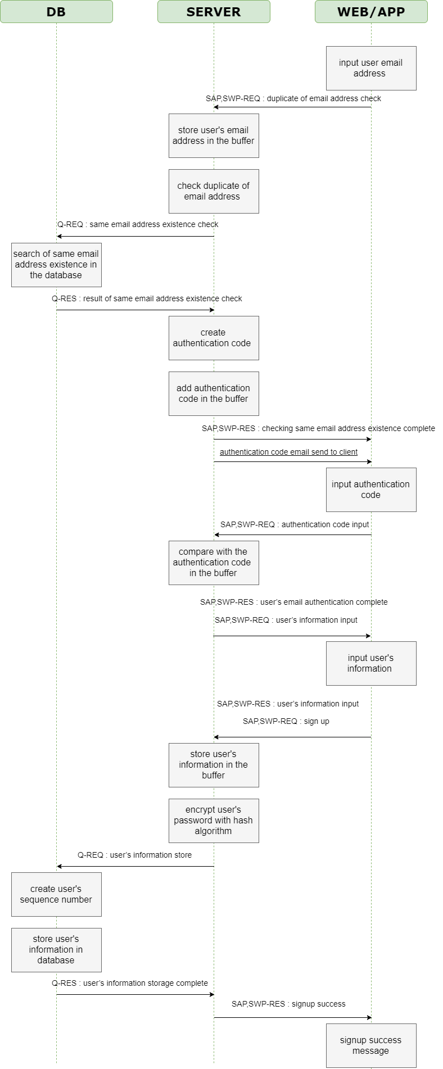
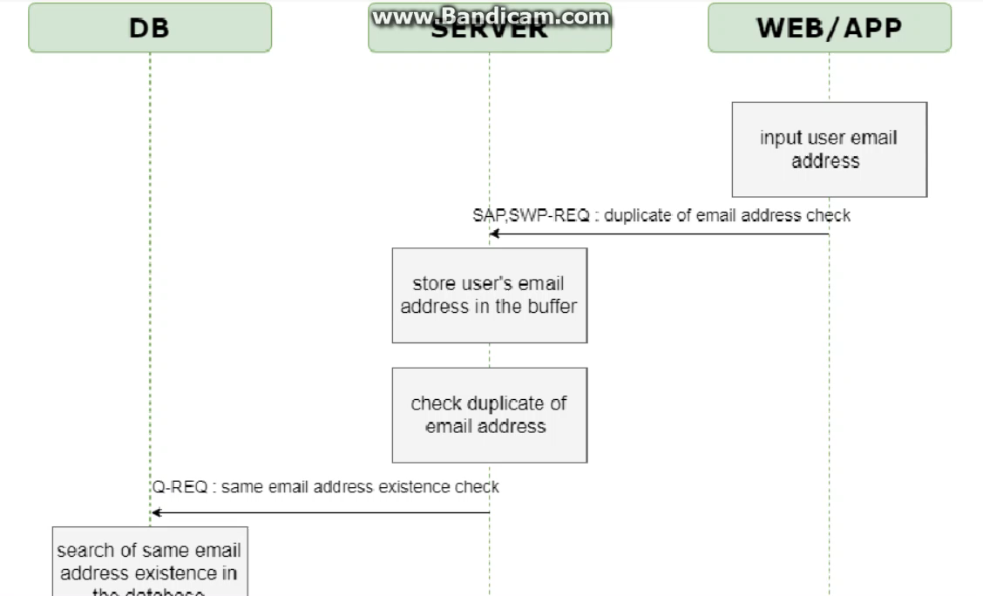
Registration Sequence Diagram
C team

Slide 5
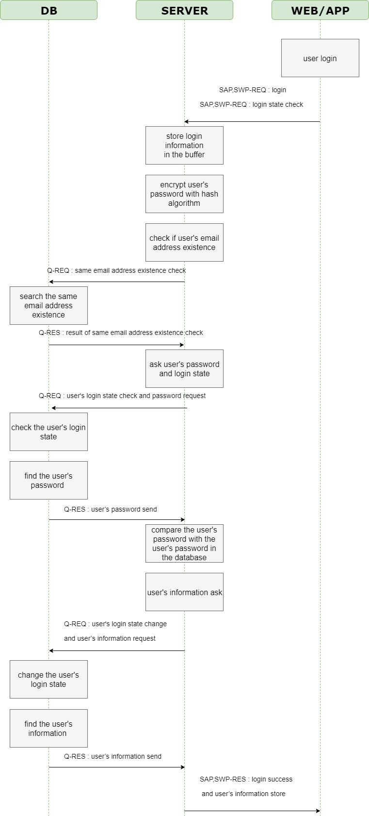
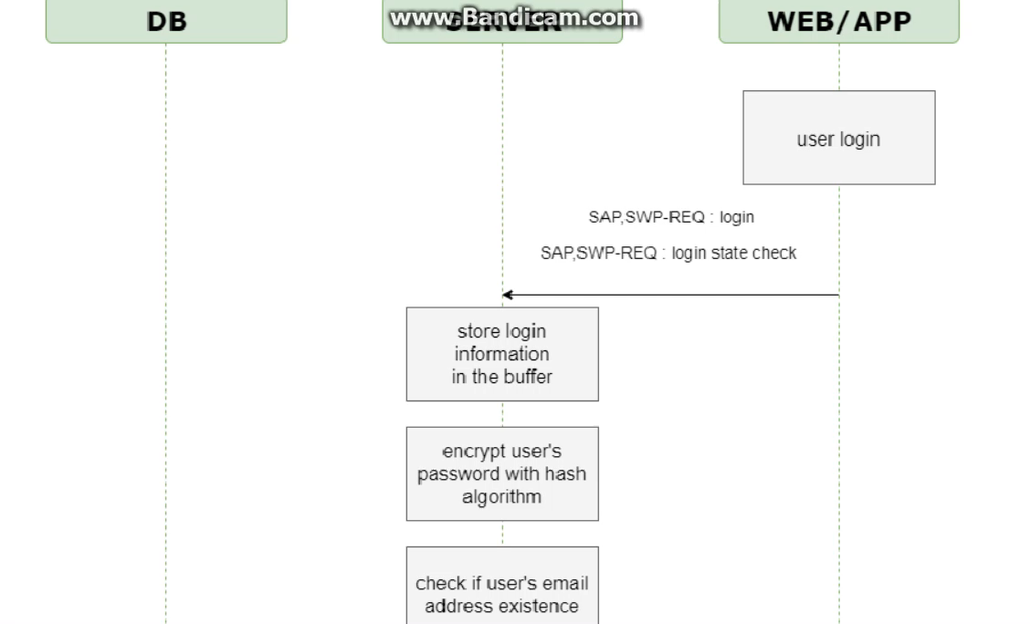
Sign-in Sequence Diagram
C team

Slide 6
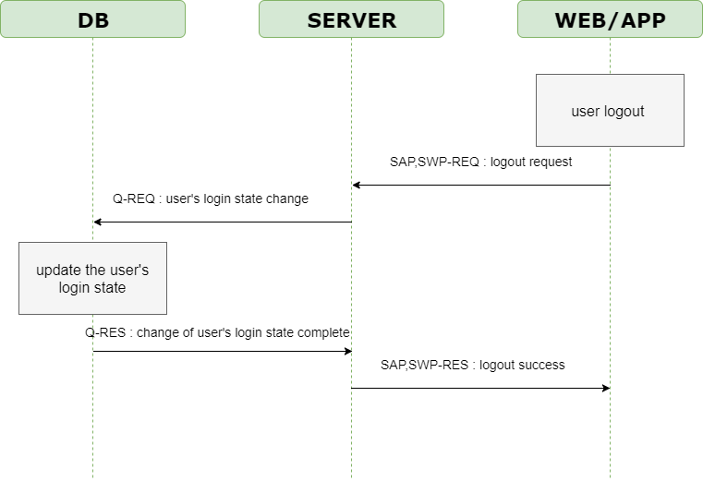
Sign-out Sequence Diagram
C team

Slide 7
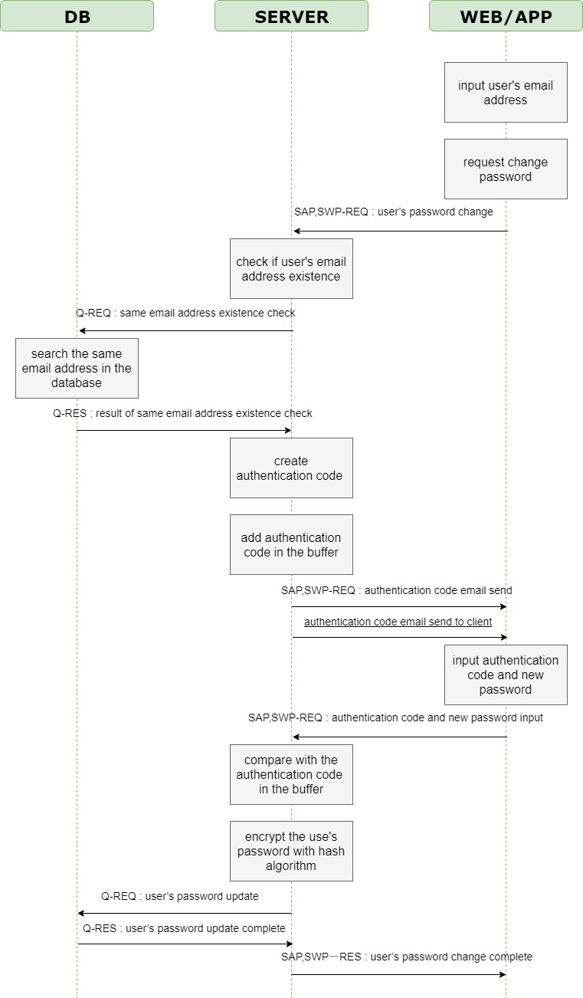
Forgotten password Sequence Diagram
C team

Slide 8
Change point of Sequence Diagram
C team
Delete duplicate information
Change authentication method in forgotten password situation
Change expression
Notes:
비밀번호 변경 방법이 이메일 인증에서 인증 코드로 바뀜
영어 표현 변경
중복 설명 제거

Slide 9
ER Diagram
C team
Qualcomm Institute

Slide 10
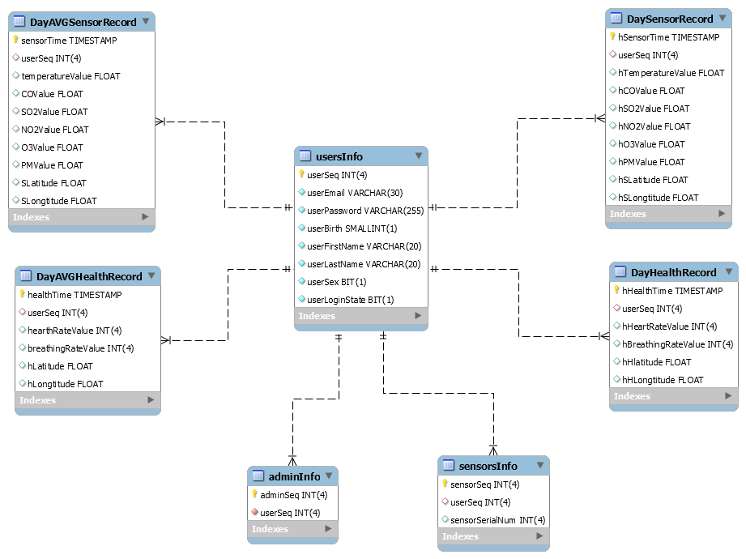
ER Diagram
C team

Slide 11
Web Client
C team
Qualcomm Institute

Slide 12
Web client
C team

Slide 13
Application UI
C team
Qualcomm Institute

Slide 14
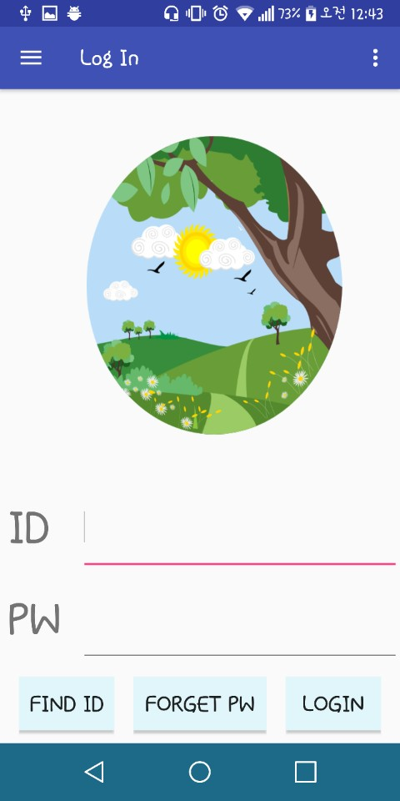
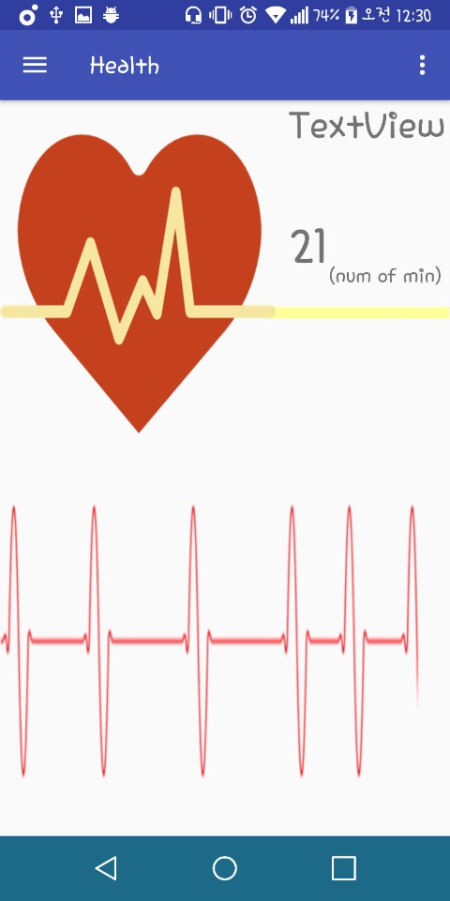
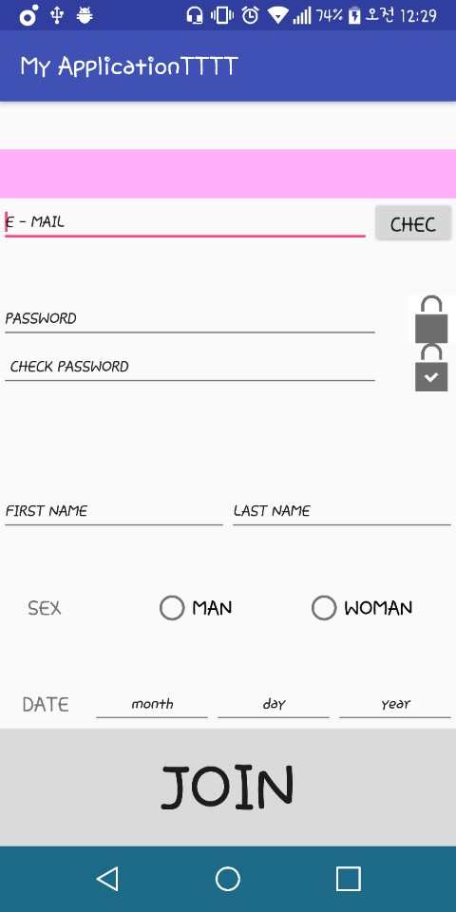
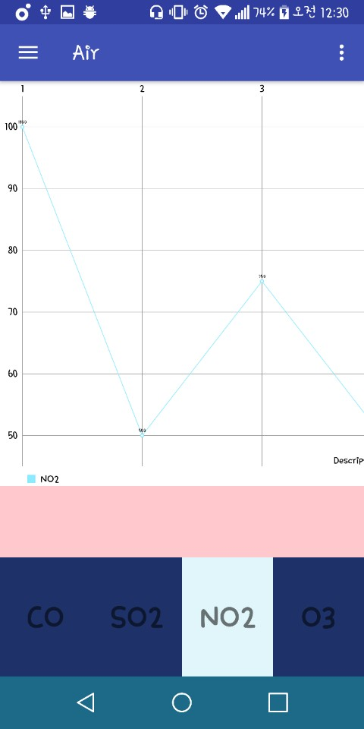
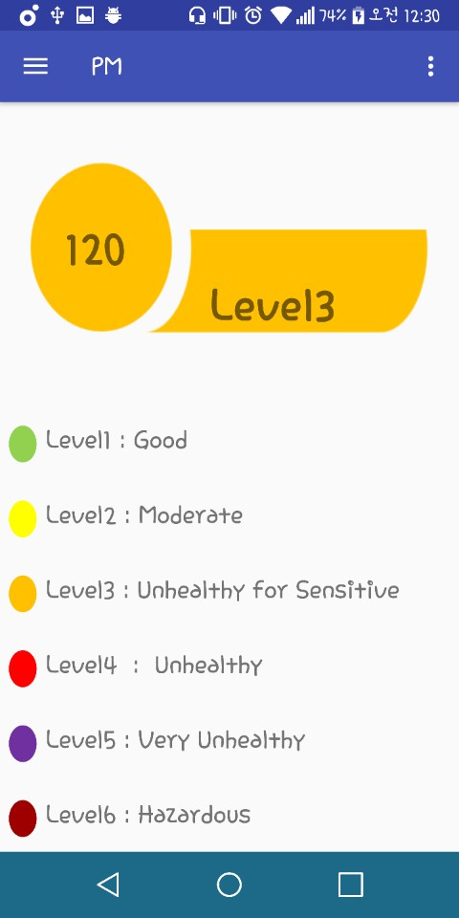
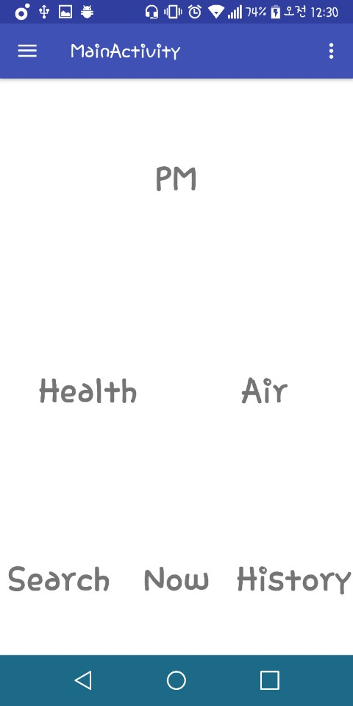
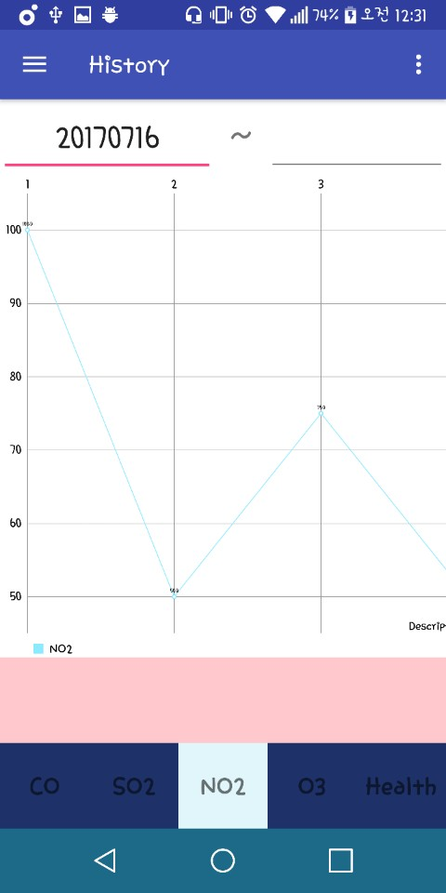
1 Week presentation
Application UI
C team

Slide 15
Thank you
Qualcomm Institute

